Slide 1
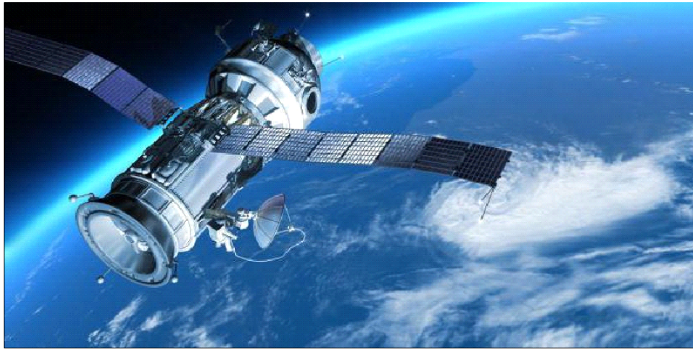
Satellites are one of the modern inventions invented by man that made the universe like a small village, and weather experts rely on them to know the weather and predict the presence of hurricanes and winds or not, as well as geology and space science experts, where these satellites take pictures of the Earth and all other planets to know The extent of the changes that occur in it, and it transmits everything that is happening in the world and broadcasts it on television screens
satellite

Slide 2
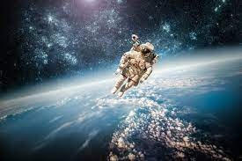
Space Student: Mohamed Ali Mohamed Grade: 3rdsecondary Subjects: 1: What is the space 2: What's in the space 3: How did scientists get to space 4: what was the benefits of exploring space

